Slide 1

Treasurers’ Training
March 2021
Financial
Affairs

Slide 2
Coverage Today
  Housing allowances
  Accountable Accts
  Administrative Topics
  How Can We Help?
  Synod Resources
  Presbytery loans / grants
  7. Cafeteria Plans
  8. Contribution Receipts
  9. Employment Records
  10. Church Purpose
  11. And More.

Slide 3
Stewardship Kaleidoscope
Happening in September this year
The
Cincinnati, Ohio
Presbytery will cover your registration which covers some meals
Hotel and travel are your responsibility
Visit www.stewardshipkaleidoscope.org

Slide 4
Contact Information
Edd – edd@breeden.us
Diane – rdtkcase@comcast.net
Presbytery Address
  890 Meridian Way,
    San Jose, Ca 95126
  (408) 279-0220

Slide 5
Directory
Site: https://directory.in-c.net/psj/
Password: theway2sanjose
You can find information about churches, locations, phone #s.
Download a current Presbytery directory.
Find the information listed about your church.
Let us know of needed changes, thank you.

Slide 6
Contributions & Receipts
Cash contributions. All cash contributions, regardless of amount, must be substantiated by either a bank record (such as a cancelled check) or a written communication from the charity showing the name of the charity, the date of the contribution, and the amount of the contribution.
Substantiation of contributions of $250 or more. Donors will not be allowed a tax deduction for any individual cash (or property) contribution of $250 or more unless they receive a written acknowledgment from the church containing the following information:
The receipt must contain one of the following: (1) a statement that no goods or services were provided by the church in return for the contribution; (2) a statement that goods or services that a church provided in return for the contribution consisted entirely of intangible religious benefits; or (3) a description and good faith estimate of the value of goods or services other than intangible religious benefits that the church provided in return for the contribution.
The written acknowledgment must be received by the donor on or before the earlier of the following two dates: (1) the date the donor files a tax return claiming a deduction for the contribution, or (2) the due date (including extensions) for filing the return.

Slide 7
Contributions & Receipts
Quid pro quo contributions of more than $75. If a donor makes a “quid pro quo” contribution of more than $75 (that is, a payment that is partly a contribution and partly a payment for goods or services received in exchange), the church must provide a written statement to the donor that satisfies two conditions:
1) the amount of the contribution that is tax-deductible
  Is limited by the value of what was received.
  must provide the donor with a good faith estimate of the value of the goods or services furnished to the donor.
2) A written statement need not be issued if only “token” goods or services are provided to the donor or the gifts given were low-cost items in comparison to the overall donation.
For 2020, token goods or services were those that cost the church no more than $11.20 to produce, contain the church’s logo, and were given in exchange for a contribution of at least $56.

Slide 8
Contributions & Receipts
Gifts of property.
noncash property valued by the donor at $500 up to $5,000.
Donor must retain certain records and complete the front side (Section A, Part I, and Part II if applicable) of IRS Form 8283 along with their 1040.
Special rules apply to donations of cars, boats, and planes valued by the donor at more than $500.The church must provide the donor with a written acknowledgment and send a Form 1098-C to the IRS containing required information about the donation. Form 1098-C can be used as the written acknowledgment that must be issued to a donor.
. Failure to file Form 1098-C can result in penalties assessed on the church and a loss of the donation deduction by the donor.
For contributions of property (not including cash) valued by the donor at $250 or more, the receipt must describe the property. No value should be stated.

Slide 9
Contribution Receipts
Name of the Organization and Name of the Donor.
Date of each contribution.
Must be contemporaneous, dated before the taxpayer files a return for year of contribution.
Amount of Cash Contribution. (In-Kind Contributions)
OR the description of the property contributed (do not estimate its value).
Whether the charity provided any goods or services for the contribution.
If only provision was intangible religious benefits, that should be stated.
On charity’s letter head is best.

Slide 10
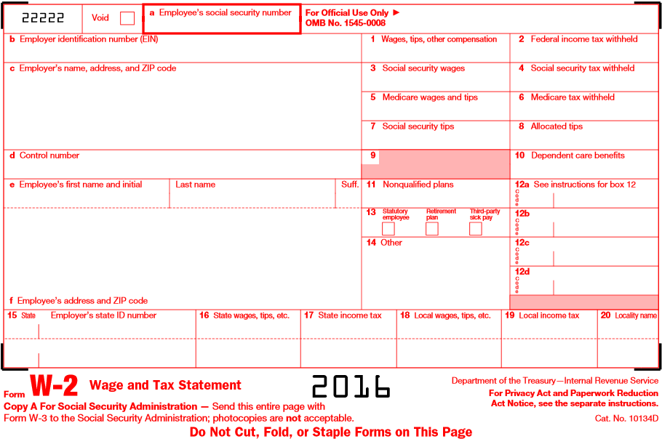
W-2 FORM
30,000
50,000
Housing allowance
40,000

Slide 11
Income
Church reimbursements of a spouse’s travel expenses incurred while accompanying a minister on a business trip
“Discretionary funds” established by a church for a minister to spend on current needs—if the minister is allowed to distribute funds for his or her personal benefit or does not have to account for the funds in an arrangement similar to an accountable expense reimbursement plan.
Imputed interest” from “below-market interest loans” of at least $10,000 made by a church to a minister
Cancellation of a minister’s debt to a church
Severance pay
Payment of a minister’s personal expenses by the church
“Love gifts”
Determining church wages or salary.
Salary (Not Including Housing)
Bonuses
The cost of sending a minister to the Holy Land (if paid by the church)
Most Christmas and special occasion offerings for the pastor
Retirement gifts paid by a church
The portion of a minister’s self-employment tax paid by a church
Personal use of a church-owned vehicle
Purchases of church property for less than fair market value
Business expense reimbursements under a non-accountable plan
Imputed cost of group term life insurance coverage exceeding $50,000

Slide 12
Housing Allowance
Continuing Court cases trying to eliminate.
Not subject to income tax if all used for approved housing expenses.
Is subject to SS and Med. SECA taxes.
Should be voted by Session preferably each December for the coming year.
Documentation; budget, accounting, contracts, etc.
Can never be retroactive but can be changed during the year.

Slide 13
Housing Allowance
What Ministers need to be aware of.
An immediate in income taxes. Adjustment to quarterly estimated payments.
Ministers who are considering the purchase of a new home should not base the amount and affordability of a home mortgage loan on the availability of a housing allowance exclusion.
Many churches may/will want to increase ministers’ compensation to offset the adverse financial impact. Could be as much as 20% Fed and 9% Cal of the current housing allowance.
The fair rental value of church-provided manses remains a nontaxable benefit.

Slide 14
Accountable Reimbursement
To be accountable, must comply with all four of the following rules:
1) Expenses must have a business connection—
2) Employees are only reimbursed for expenses for which they provide an adequate accounting within a reasonable period of time (60 days)
3) Employees must return any excess reimbursement or allowance within a reasonable period of time (not more than 120 days)
4) The reimbursement requirement means that an employer’s reimbursements of an employee’s business expenses come out of the employer’s funds and not by reducing the employee’s salary.
KEY POINT
Reimbursements of business expenses under an accountable arrangement are not reported as taxable income on an employee’s Form W-2 or Form 1040, and there are no deductions to claim.

Slide 15
Cafeteria Plans
Types of Accounts
Section 125 Plan Cafeteria Plans allow an employee to elect to reduce cash salary and pay dues contributions with pre-tax wages.
Employer medical reimbursement arrangements (sometimes referred to as wrap-around plans) — Some churches offer medical reimbursement arrangements for medical expenses that are not reimbursed by the Medical Plan. These arrangements are not subject to income tax or Social Security tax if they are provided as a group plan established to reimburse employees for medical expenses not covered by the plan (for example, deductibles and coinsurance).
Flexible Spending Accounts (FSA)
Health Reimbursement Arrangements (HRA)
Health Savings Accounts (HSA) High Deductible Plan
Beginning in 2019, the PC(USA) Medical Plan offers an HDHP option and an HSA vendor, Further.

Slide 16
Misc. News
Auto mileage reimbursement, 56 cents per mile.
403b deferred contribution cap is 19,500 and 6,500 catch-up. Max for employer is 57,000
Medicare surtax over 200,000 single, 250,000 married is .09

Slide 17

Ministers, AND CHURCH EMPLOYEES

Slide 18
Financial Affairs committee
Interested in being on a Presbytery committee? i.e. Financial Affairs or know of someone who would like to be on any committee?
Contact, the Presbytery Office.
The chair of the Nominating Committee is Lindsay Woods Wong RevLAWW@gmail.com

Slide 19
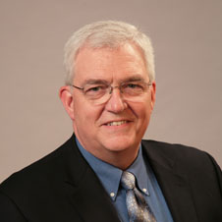
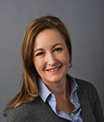
Board of Pensions & Foundation
Mark Frey – Board of Pensions
Consultant for Synods of Alaska-Northwest and the Pacific, and part of Synod of the Rocky Mountains (Montana, Wyoming)
Maggie Harmon - Foundation
Serves as the Ministry Relations Officer for the Southwest. She works with congregations to create a culture of generosity, offers seminars and workshops, develops gifts, etc.

Slide 20
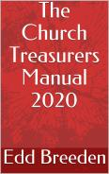

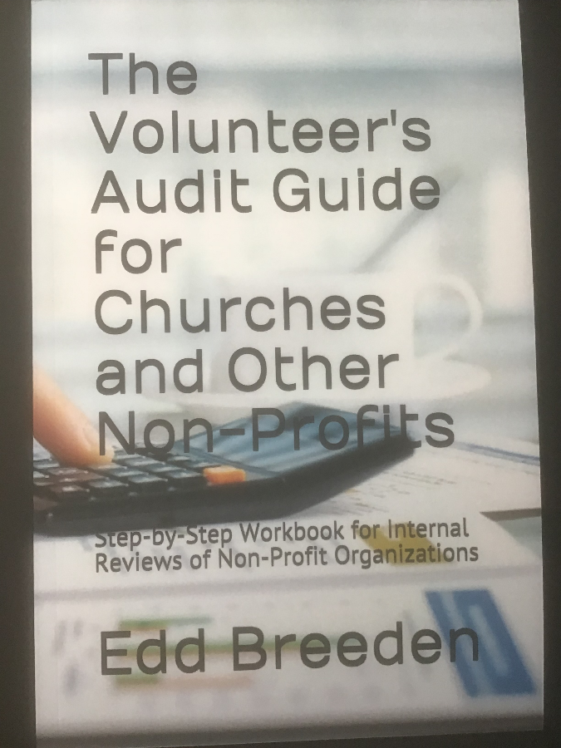
Completely Reformatted and Revised for 2020.
250 pgs. 8 2/1 x 11

Slide 21

ADMINISTRATIVE TOPICS

Slide 22
SYNOD LOAN APPLICATIONS
First send to the Presbytery of San Jose, ATTN DIANE.
DO NOT SEND TO SYNOD.
Require Financial Affairs reviews and approval
and send those that need to get Presbytery approval on to Presbytery. I.E. 5 YEAR LEASES. Why?
Once the Presbytery approves it, FA forwards it on to the synod for their approval.
Financial Affairs meets the 3rd Wednesday of the month but Presbytery only meets four times a year and synod meets February, May, August, October.

Slide 23
Automatic Payments
When you set up auto payments
Have someone to monitor
Review them annually
Have someone who knows how to unravel them
Change passwords, etc. annually, when someone leaves employment etc.

Slide 24
Documents
Review your documents, articles, by-laws, policies, every three years to keep them up to date.
Actually, do you know where they are?
  The Presbytery Office should have an up to date copy.
When was the last time they were reviewed?
Minutes should be complete enough to have a new board come in and pick up where you left off.

Slide 25
LOCATION OF VALUABLE PAPERS
Articles of Incorporation.
Corporate Resolutions
Bylaws, review and update every 3 years
Annual 571L. (later in presentation);
OCC certificate
Annual Exemptions; Religious, Welfare, Church. (later)
Deeds of property, Insurance papers
Church Exemption Letter (next slide)

Slide 26
TAX EXEMPT LETTER
A copy of a Tax Exempt letter for your church can be obtained by contacting the Presbytery Mission Agency, General Council’s office, in Louisville.
Email or contact Rebecca Rayner
  Email Rebecca.rayner@pcusa.org
  Phone
She will need your church name & contact info. & Tax ID Number

Slide 27
WIRING MONEY OVERSEAS
Presbytery of San Jose cannot be responsible for International correspondent banking instructions associated with any fed wire transfers and we cannot make any International SWIFT payments or International Clearing House Payments.
We cannot collect the money.

Slide 28
OTHER THOUGHTS
If you change your internal controls because you are working remotely, you need to write them up and keep them on file for when you get audited next year.
  i.e money might not have two people counting
  i.e. two signature checks?
  Email approvals.
Reminder trust is not an internal control.

Slide 29
AUTOMATIC PAYMENTS
When you set up auto payments
Have someone to monitor
Review them annually
Have someone who knows how to unravel them
Change passwords, etc. annually, and when someone leaves employment etc.

Slide 30
EMPLOYEE MANUAL
info on benefits, disabilities, wages, vacations, sick days, etc.
grievance procedures, discrimination, harassment and abuse, and how you will handle complaints
Samples are available for a variety of costs from free to consultants who charge $5,000. Find what works for you.

Slide 31
EMPLOYEE FILES
Official paperwork; application, record of hire, annual reviews, I9 (e-verify), wage changes, annual W4 or W9 forms, address, phone, emergency contact, direct deposit authorization, and other paper work.
Every position has a job description showing who they work for, what they are expected to do, how they will be evaluated, etc.

Slide 32



SOURCES OF INCOME

Slide 33
Our Purpose, UBI
Tax exempt organizations are organized and operated exclusively for their stated exempt purpose and should avoid all other uses and/or programs.
  Exempt means no net earnings inure to the benefit of any private shareholder or individual.
  And tax exempt should not be involved in any political activity.
  The presence of a single, substantial nonexempt purpose or activity can destroy your tax exempt status.
  i.e. leasing to for profit
  i.e. Teacher teaching piano to non-church students for pay. i.e. profit.

Slide 34
Leasing Church Property
Policy Statement.
  Please read this before you use the lease forms
Short term lease form. (presbytery does not need)
  For less than three days and/or one-time events.
Long term lease form.
  Anything over three days or recurring events.
Find on website, www.sanjosepby.org, forms
Leases should require proof of insurance and proof of 501c3 designation. Do not take their word for it.

Slide 35
Leasing Church Property
One of the biggest issues about working with other organizations inside our church facilities is this question:
How is the Project consistent with the mission of the church; i.e. is it truly MINISTRY? Does it somehow conform to our mission according to our Articles of Incorporation and By Laws?

Slide 36
MONEY AVAILABLE FOR PROJECTS
Community Mission or Congregational Renewal (Audio Visual equipment is high on the list of needs.)
Also Church Vision Grants
Application Forms (available on-line)
http://www.sanjosepby.org/committees/financial-affairs-ministry-forms/
Loans from Synod

Slide 37
Synod loan applications
First send to the Presbytery of San Jose, ATTN DIANE.
DO NOT SEND TO SYNOD.
Require Financial Affairs reviews and approval
  and send those that need to get Presbytery approval on to Presbytery. I.E. 5 YEAR LEASES. Why?
Once the Presbytery approves it, FA forwards it on to the synod for their approval.
Financial Affairs usually meets the 3rd Wednesday of the month but Presbytery only meets four times a year and synod meets February, May, August, October.

Slide 38
HANDLING MONEY

Slide 39
Policies, Best Practices
Best Practices for church finances include the following policies:
  Accountable reimbursement.
  Credit Card use and reimbursement.
  Gift Acceptance.
  Investment.
  Check writing / signing.
  Finance review practices, internal or external audits/reviews.
  Conflict of Interest.
  Property use.

Slide 40
ANNUAL FINANCIAL REVIEW
A financial review of all financial books and records shall be conducted every year by a public accountant or a committee of members versed in accounting procedures. Reviewers should not be related to the treasurer.
Goal to prevent Fraud and to improve practices.
Smaller churches could connect with others to do each other’s reviews.

Slide 41
Investment Policy
Describes who is responsible for investing.
States the objectives and the strategies of investing.
Describes the level of risk the church is willing to take.
Lists the Asset Allocation parameters for Cash, /Fixed Income, and Equity Assets.
Lists specifically any acceptable and non- acceptable investments.
Delineates the Spending Policy and who and why these can be overridden.

Slide 42
GIFT ACCEPTANCE POLICY
What you will receive and what you won’t.
How the Church handles money they do receive.
What a donor needs to do to restrict the use of their gift.
How the Session will handle Restricted Funds.
How donors can give to the church in their wills.
What the church does with money given “in memory of?”
Setting a timeline for designated funds.

Slide 43
STATEMENT OF FINANCIAL POSITION
Also called – the Balance Sheet
Lots of discussion, detail, why??
Etc.
Assets and Liabilities
Restricted Accounts
No co-mingling.
Notes related to restrictions, history, amounts, uses
Treatment of Church buildings
  Manse

Slide 44
Funds with restrictions
Funds with Donor Restrictions
  Session approve before check is deposited
  Session to work with giver, where possible, to set
    A clarification on the use of funds, i.e. broaden the use
    A length of time on the use of funds
    What will be done with any funds left in the account when time is up
Funds without Donor Restrictions
  General Funds
  Funds Restricted by Session

Slide 45

ANNUAL FILINGS

Slide 46
VARIOUS FORMS
Payroll Forms like 940, 941, DE 9, D9C
Statement of Information, Secretary of State
  Businessfilings.sos.ca.gov and search for your church
Form 571L Business Property Statement
  Lists property owned by the church
  Including furniture, landscaping, etc.
  It is another form of tax and they will send you a bill.
Tax forms like 990 if you have Unrelated Business Income.

Slide 47
EXEMPTIONS
Religious Exemption, 267-S,
  all churches file annually,
  One Question; are you still a church, i.e. religious purposes?
Welfare Exemption, 267 / 267-A,
church who allows other organizations to use space or rent space must file this annually,
Supplemental Form, 267-O, church who allows other organizations to use space or rent space must file this annually,
Church Exemption, 262– AH, any church that does not have its own building but is renting space.

Slide 48
FILING EXEMPTIONS
https://www.capropeforms.org/counties/
Monterey – co.Monterey.ca.us
San Benito – cosb.us
Santa Clara – sccassessor.org
Santa Cruz – co.santa-cruz.ca.us

Slide 49
ANNUAL STATISTICAL REPORT
Clerk is responsible but …
      they need numbers
Value Now – gives info to the middle governing bodies.
Value Future – helps you and your pastors evaluate.
Round numbers to nearest hundreds.
Estimate as best you can.
Make sure to print before submitting.
Session should approve before submitting.

Slide 50
PER CAPITA
“Per capita funding is how Presbyterians mutually share the costs of coming together to discern the Spirit’s leading for the future.” (http://www.pcusa.org/percapita/)
There is a 1 year lag in membership data, i.e. 2019 per capita is based on Dec 2017 membership data.
Mail checks to Presbytery Office. Presbytery no longer allows online payment.
Lower Per Capita by accurately maintaining rolls.

Slide 51
SAN JOSE PER CAPITA
Thank you for your giving to per capita
The current per capita is:
  $40.00
  plus .50 voluntary for Theo Edu
Presbytery $25.83
Synod $ 5.22
GA $ 8.95

Slide 52
990 FORM
What does the 990 ask?
Are you financially benefiting your major givers?
Do you have UBI?
Loans to officers of the church?
Did you solicit any contributions that were not tax deductible?
Do you have a document retention and destruction policy?

Slide 53
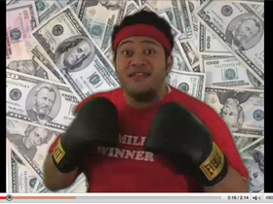
PROTECTING YOUR ASSETS

Slide 54
PREPARING FOR DISASTERS earthquakes, fires, (electrical), etc.
(hire a public adjuster to help with ins)
Pictures
  Use and Don’t use
  Cost of Purchase
  Renters should also
  A way to approve immediate funds, up to 10,000
  Wish list on line for people to donate
Mobilization
  If total, how do you continue to meet
  Don’t change the time you meet
Panic buttons
Seating meets your parking (if rebuild)

Slide 55
Insurance
Sexual harassment claims are still the number one claims in churches. Have a policy and communicate to our staff and volunteers annually. Make sure your church has sufficient insurance.
Property issues are number two in insurance claims.

Slide 56
Insurance
Related to insurance, if you have a potential claim, contact your agent, do not try to be kind to the perpetrator by reaching out and saying things that might cause problems in resolving the claim. Please do not apologize or seem to accept some blame, leave that to the findings of the insurance company.

Slide 57
Security issues
Cyber security
Social engineering is phishing usually in form of email. Looking for passwords, account numbers, pin numbers (google docs used to get information and your signature) smishing is text message based trying to get passwords and account numbers
Business email compromise is spoofed email trying to get money out of you. Impersonating employee or company. Check the display name to is if it is correct. Usually it is a display of visual trickery
Common wording in emails. There are programs that can filter bad words or common words that might be spoofed. Beware of sense of urgency in an email.

Slide 58
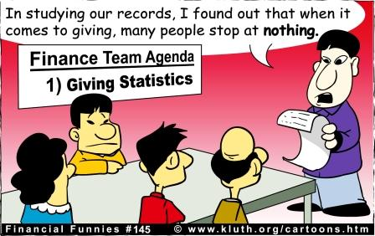
STEWARDSHIP

Slide 59
Who Talks about Money?
Churches -- 2-3 weeks per year.
Mission Orgs -- 40% of the time.
Non- Denominational Groups -- 40% of the time.
Bible – 135 paragraphs, stories, related to money in the New Testament alone.

Slide 60
Giving Facts
86% of people under 35 prefer to give electronically.
14% of churches allow electronic giving.
50% of attendees at church give cash in the plate or nothing.

Slide 61

Appendices

Slide 62
Resources
Articles on church finances and tax law.
http://www.wkpz.com/nonprofit_articles.php
Frank Sommerville, non-profit attorney
  fsommerville@nonprofitattorney.com
Elaine Sommerville, non-profit accountant
  Elaine@nonprofit-tax.com
Kaleidoscope Conference Notes from 2016
  http://stewardshipkaleidoscope.org/conference-resources/2016-conference-resources/
Kaleidoscope Conference – Fall 2017, Florida
  www.stewardshipkaleidoscope.org

Slide 63
MDC s
LOANS
LOCAL
CHURCHES
ALL MISSION $
PER CAP
SYNOD LOAN & INVESTMENT PROGRAM
GENERAL ASSEMBLY
PRESBY STAFF FOR MISSION PROGRAM EP AND SEC
SYNOD MISSION
Pass thru
SYNOD OPERATIONS
PRESBY MISSION PROGRAM
PRESBY ECCLESIASTICAL OPERATIONS
CLERK, TREAS, ACCOUNTANT
Operations Budget
DISMISSAL MONIES
Undecided
PRESBYTERY INVESTMENT PROGRAM

